Slide 1
Sequential Circuits
Part 3

Slide 2
The Key Takeaways Obtained So Far
SR Latch
Truth Table
Trigger
Level Trigger and Edge Trigger
SR Flip Flop
Truth Table, Characteristics Table and Excitation Table
D Flip Flop
Truth Table, Characteristics Table and Excitation Table
JK Flip Flop
Truth Table, Characteristics Table and Excitation Table
Racing Problem
Master Slave JK Flip Flop

Slide 3
T FLIP FLOP

Slide 4
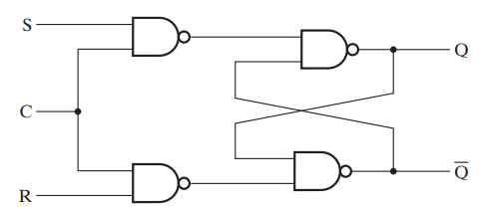
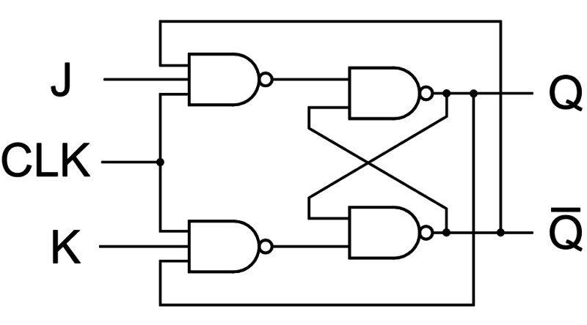
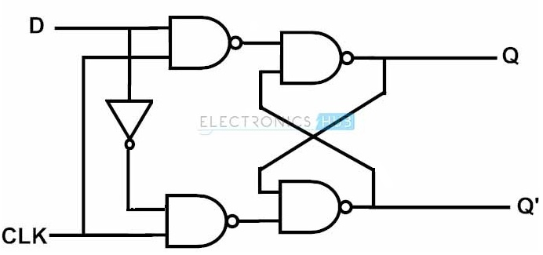
T Flip Flop
We can place entire logic circuits inside boxes

Slide 5
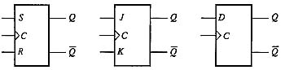
T Flip Flop
We can place all entire logic circuits inside boxes
Only the input and output pins will be shown

Slide 6
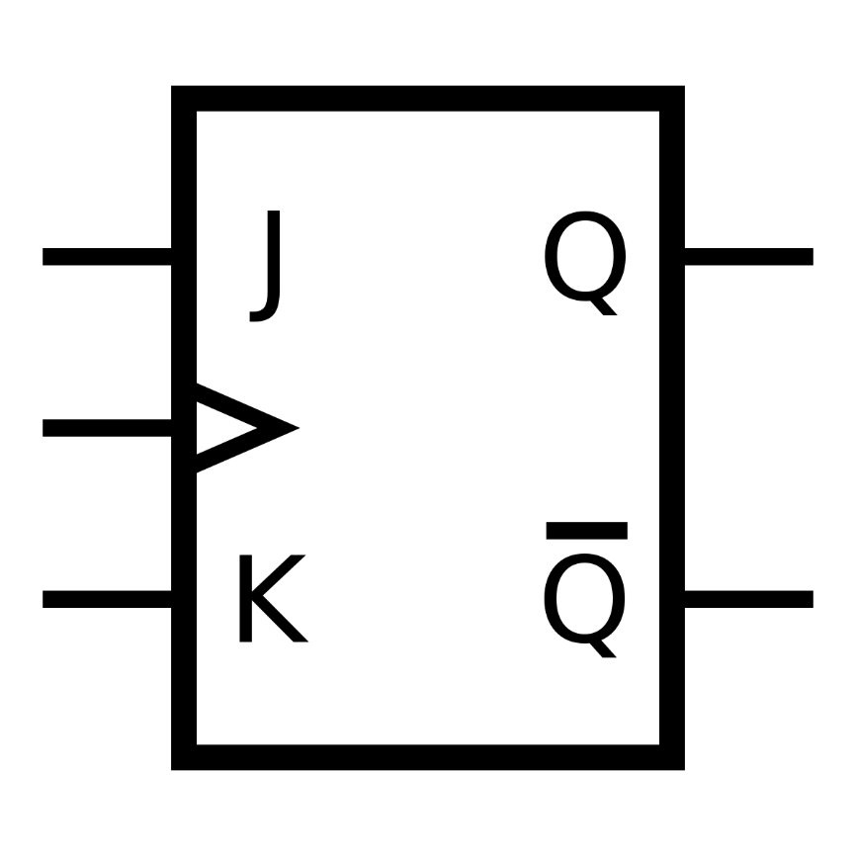
T Flip Flop
We will construct a T flip flop from JK flip flop
T stands for toggle. It will only toggle the content (Q) stored inside

Slide 7
T Flip Flop
We will construct a T flip flop from JK flip flop
T stands for toggle. It will only toggle the content (Q) stored inside
T
C

Slide 8
T Flip Flop
What are the possible inputs of J and K now?
T
C

Slide 9
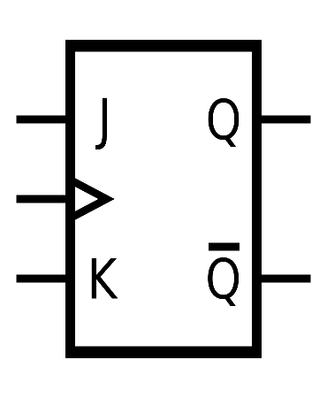
T Flip Flop
The Three Tables
T
C
Truth Table
Charactersitics Table
Excitation Table
C | T | Q_{n+1}
0 | X | Q_{n}
1 | 0 | Q_{n}
1 | 1 | Q_{n}’
Q_{n} | T | Q_{n+1}
0 | 0 | 0
0 | 1 | 1
1 | 0 | 1
1 | 1 | 0
Q_{n} | Q_{n+1} | T
0 | 0 | 0
0 | 1 | 1
1 | 0 | 1
1 | 1 | 0

Slide 10
T Flip Flop
The Three Tables
T
C
Truth Table
Charactersitics Table
Excitation Table
C | T | Q_{n+1}
0 | X | Q_{n}
1 | 0 | Q_{n}
1 | 1 | Q_{n}’
Q_{n} | T | Q_{n+1}
0 | 0 | 0
0 | 1 | 1
1 | 0 | 1
1 | 1 | 0
Q_{n} | Q_{n+1} | T
0 | 0 | 0
0 | 1 | 1
1 | 0 | 1
1 | 1 | 0

Slide 11
FLIP FLOP CONVERSION

Slide 12
Flip Flop Conversion
The following steps can be followed for flip flop conversion
Identify the available flip flop and the required flip flop
Make the characteristic table for the required flip flop.
Make the excitation table for the available flip flop.
Extend the characteristics table
Write the Boolean expression for the available flip flop
Draw the circuit

Slide 13
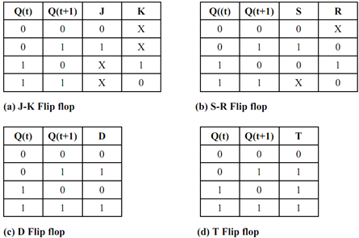
Flip Flop Conversion
Recall Excitation table

Slide 14
Flip Flop Conversion
Let us perform the following conversions
JK Flip Flop to D Flip Flop
T Flip Flop to D Flip Flop
SR Flip Flop to JK Flip Flop
SR Flip Flop to T Flip Flop

Slide 15
PRESET AND CLEAR INPUTS

Slide 16
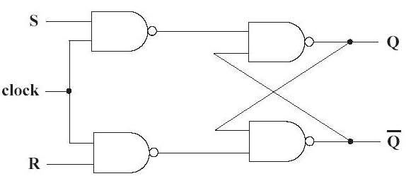
Preset and clear inputs
Let us consider the following SR Flip Flop for understanding

Slide 17
Preset and clear inputs
Let us consider the following SR Flip Flop for understanding

Slide 18
Preset and clear inputs
Let us consider the following SR Flip Flop for understanding
Preset
Clear

Slide 19
Preset and clear inputs
Let us consider the following SR Flip Flop for understanding
Preset
Clear

Slide 20
Preset and clear inputs
Let us consider the following SR Flip Flop for understanding
Preset
Preset | Clear | Q_{n}
0 | 0 | Not Used
0 | 1 | 1
1 | 0 | 0
1 | 1 | Normal Functioning
Clear

Slide 21
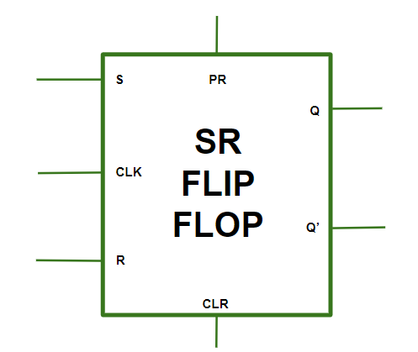
Preset and clear inputs
Let us consider the following SR Flip Flop for understanding
Preset
Clear

Slide 22
STATE DIAGRAMS

Slide 23
State Diagrams
What is a state?
In a sequential circuit we will find inputs – A,B,C
In a sequential circuit we will find outputs – F,E
In a sequential circuit we will find states
Q
Q_{n}
Q_{n+1}

Slide 24
State Diagrams
Let us start by making the state diagram of a JK flip flop
Characteristic Table
How the state changes based on input
Q_{n} | J | K | Q_{n+1}
0 | 0 | 0 | 0
0 | 0 | 1 | 0
0 | 1 | 0 | 1
0 | 1 | 1 | 1
1 | 0 | 0 | 1
1 | 0 | 1 | 0
1 | 1 | 0 | 1
1 | 1 | 1 | 0

Slide 25
State Diagrams
Let us start by making the state diagram of a JK flip flop
Characteristic Table
How the state changes based on input
1x
Q_{n} | J | K | Q_{n+1}
0 | 0 | 0 | 0
0 | 0 | 1 | 0
0 | 1 | 0 | 1
0 | 1 | 1 | 1
1 | 0 | 0 | 1
1 | 0 | 1 | 0
1 | 1 | 0 | 1
1 | 1 | 1 | 0
0x
S0
S1
x0
x1

Slide 26
Thank You

